Slide 1
Fun Facts
The name “NoSQL” was in fact first used by Carlo Strozzi in 1998 as the name of file-based database he was developing. It was a relational database.
Neal Ford coined the term Polyglot Programming in 2006
SABRE, a database still used in the airline industry, predates relational databases (however, they began using a relational database is 2001)
Ingres and System R were two early relational database prototypes in the 70s
The term "relational database" was invented by E. F. Codd at IBM in 1970
Some claim that “NoSQL” now means “Not Only SQL”, and that it isn’t anti-relational
Rackspace used the term “NoSQL” for a conference in 2009.
Terms: “Relational Winter” gives way to “Database Thaw” (ok, not a fact, but still fun)

Slide 2

Which Azure Database Option Should I Choose?
Anne Bougie Senior Software Developer Concurrency, Inc.
Twitter: @bougiefever
Understanding Database Options

Slide 3
Which Azure Storage Option Should I Choose?
Anne Bougie
Senior Software Developer, Concurrency Inc.
@bougiefever
http://www.bougiefever.com
https://github.com/bougiefever

Slide 4
Ways to Store Data in Azure (Non-Inclusive)
SQL
Azure SQL
DocumentDb (Cosmos)
Azure Table Service (Cosmos)
Azure Redis Cache
Hbase
Gremlin (Cosmos)
NoSQL
Notes:
What I.m going to cover today is an overview of several of the types of storage options in Azure, how they compare to one another.

Slide 5
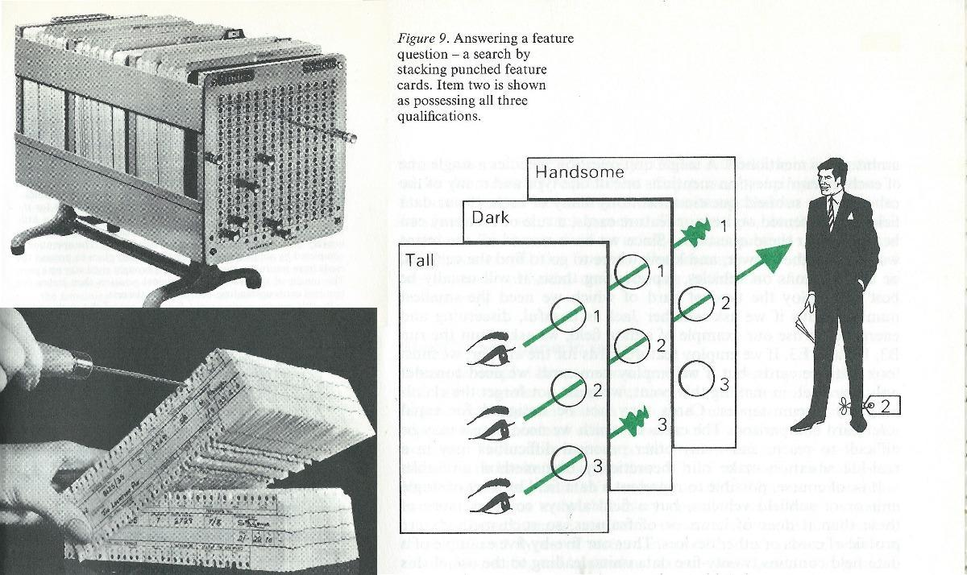
Notes:
In the past, before my time even, there were many ways to store data. Punch cards, paper reels, dewey decimal system.

Slide 6
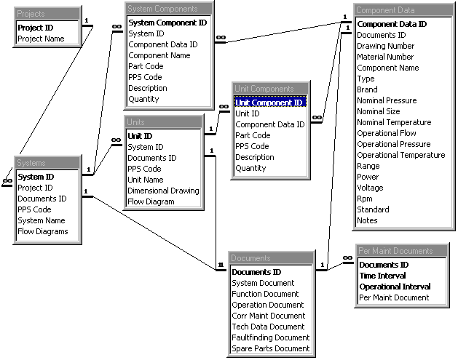
Notes:
In the 80s, Relation Databases became popular, and have remained so, and will continue to be. In fact, RDBMSs have been so popular, that the choice hasn’t been which data storage option to choose, but how are we going to set up our tables, where are the foreign keys, indexes and so on.
Talk about paper machine telemetry.

Slide 7

SQL
NoSQL
Relational
Schema-less
Persistent
Clusters
Schema
Scalability
Transactional
Sharding
Concurrency
Partitions
Data Integrity
Fast Data Access
Notes:
Since NoSQL covers such a broad range of data storage types, it really doesn't have a clear-cut definition. Set's start out by listing some of the words we use to describe them.
On the SQL side, we talk about schema, table relationships, transactions, enforcing data and referential integrity
On the NoSQL side, you hear a lot of chatter about no schemas - this is considered one of the many benefits of NoSQL - Scalability, partitioning - and you may have heard about the fast data access
Talk about Schema-less vs schema here!

Slide 8
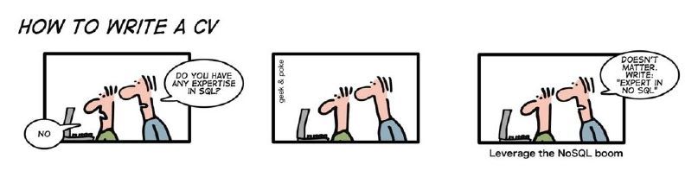
Sql vs NoSql vs Excel Spreadsheets
Notes:
Today, however, with NoSQL offerings, that choice is not as clear cut. Designing the data storage has never been a clear cut, easy task, and it’s even more complex now.
So, hopefully I can shed some light on what options there are, and what the trade-offs are between choosing one over another.
Since Relational database have been so popular, let's try to define what NoSQL is.
if you starting a new strategic enterprise application you should no longer be assuming that your persistence should be relational. The relational option might be the right one - but you should seriously look at other alternatives.

Slide 9




SQL
NoSQL
Querying Data
Transactions
Scalability
Configuration/Management
Schema
Speed
Notes:
Since NoSQL is not that easy to define, I thought it made sense to compare some of the features against one another.
SQL - Bubbles/NoSQL Buttercup
Querying - (SQL) very strong query support/joining - you can even join tables in different database - RDBMS is an integration tool
NoSQL side - There are tools to help with indexing and querying, but the tools themselves fall short in this area.
This may or may not be a problem, depending on your application
Transactions - Relational databases are the golden standard. That's not to say that NoSQL doesn't have transactional support, but Bubbles is the clear winner. Redid Cache has no concept of a transaction.
Scalability - NoSQL it's one of the biggest reasons No SQL was invented. Sharding is something that is planned for when you first set up your database - you must provide a partition key.
Configuration/Management - (NoSQL) Had to go with NoSQL. Adding or dropping fields is as simple as either saving or not saving them in your code. Both Azure SQL and DocumentDb offer geo-redundancy and failover, but DocDb does it more gracefully and without any changes to your apps to reflect the change
Schema - If you want strong control over your data at the database level, clearly Bubbles is the winner. However, if you want the flexibility that schema-less has, then Buttercup wins.
Talk about schematic vs schema-less
Speed - Again, one of the reasons it was invented was to deliver fast speeds when you have lots and lots of data. We all know SQL queries against many millions of rows are slow, even with indexing.

Slide 10

SQL
NoSQL
Notes:
Scalability - So - we have our data on our servers in the cloud and we need to scale.
social networks, activity in logs, mapping data.
In SQL Server, our only option, really, is to scale up to a larger, faster server. There are some horizontal scaling options, but it is tricky to set up and maintain.
(show)
(NoSql) Partitioning and scaling horizontally is very easy to do, and after setting up the partition key, you really don't have to do much at all - That being said, you need to think a lot about what you choose for your partition key, because a wrong choice will mean poor performance. Entities that are retrieved together need to be in the same partition so you don't end up hitting

Slide 11

Impedance Mismatch
Order
Order
Order Id: 1234
Player: Mojo Jojo
The object-relational impedance mismatch is a set of conceptual and technical difficulties that are often encountered when a relational database management system (RDBMS) is being served by an application program (or multiple application programs) written in an object-oriented programming language or style, particularly because objects or class definitions must be mapped to database tables defined by relational schema.
Player Assets
In-App Purchase
1 | Gems | 250 | $5
2 | Potions | 10 | $10
Line Items
Financial
Credit Card: 4012888888881881
Expiration: 5/2020
Credit Card
Notes:
When object-oriented program is persisted to a RDBMS (relational database management system)
A cohesive set of data in your program gets persisted to several different tables
ORMs created to handle this problem
Order – we think of an order as one thing, but Order/LineItem – when we save it, we need to split it out

Slide 12
NoSQL (Document)
{
orderId: 1234,
player: ‘Mojo Jojo’,
inAppPurchase {
date: 1/1/2017,
items: [
{
objectType: ‘Gem’,
quantity: 250,
priceEach: 0.02
},
{
objectType: ‘Potion’,
quantity: 10,
priceEach: 1.00
}
]
}
…
Order
Order Id: 1234
Player: Mojo Jojo
In-App Purchase
1 | Gems | 250 | $5
2 | Potions | 10 | $10
Financial
Credit Card: 4012888888881881
Expiration: 5/2020
Notes:
Talk about schema/not lack of stucture

Slide 13
NoSQL
Key-Value
Document
Azure SQL
DocumentDb
Azure Table Service
Azure Redis Cache
Azure Hbase
Gremlin
Graph
Column Family
Notes:
Document: DocumentDb/MongoDb/CouchDb
Json – Complex hierarchical structures – can pull out parts of document
------
KeyValue: Azure Table Storage/SimpleDb/DynamoDb/Riak
Simpleist – Glorified Dictionary/Hashmap
Redis Cache/Redis/Memcached
ColumnFamily: Azure Hbase/Apache Hbase/Cassandra (Apache)/BigTable
Graph: Neo4J/OrientDb

Slide 14

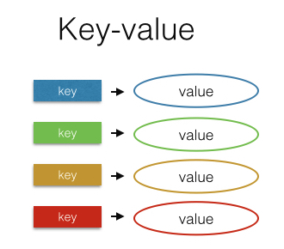

Key Value
Notes:
Azure Table Storage/Azure Redis Cache/DynamoDb/Riak
KeyValue: Azure Table Storage/SimpleDb/DynamoDb/Riak
Simpleist – Glorified Dictionary/Hashmap
No set schema – need structure – Implicit Schema to get info out and to deserialize
Partition along partition key
Azure Storage - Retrieve data with partition key and row key
Redis Cache – Retrieve data with key

Slide 15
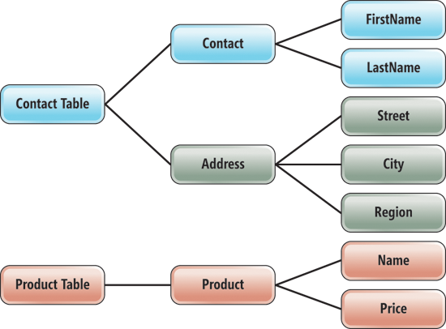
Azure Table Service
Fast reads & writes
Flat data structure
Schema-less
Partition key
Row key
Time stamp
Service will scale out using partition key
Notes:
500 TB
1MB each row
252 properties each table
Edm.Binary.
Edm.Boolean.
Edm.DateTime.
Edm.Double.
Edm.Guid.
Edm.Int32.
Edm.Int64.
Edm.String.
PartitionKeys and RowKeys Drive Performance and Scalability

Slide 16
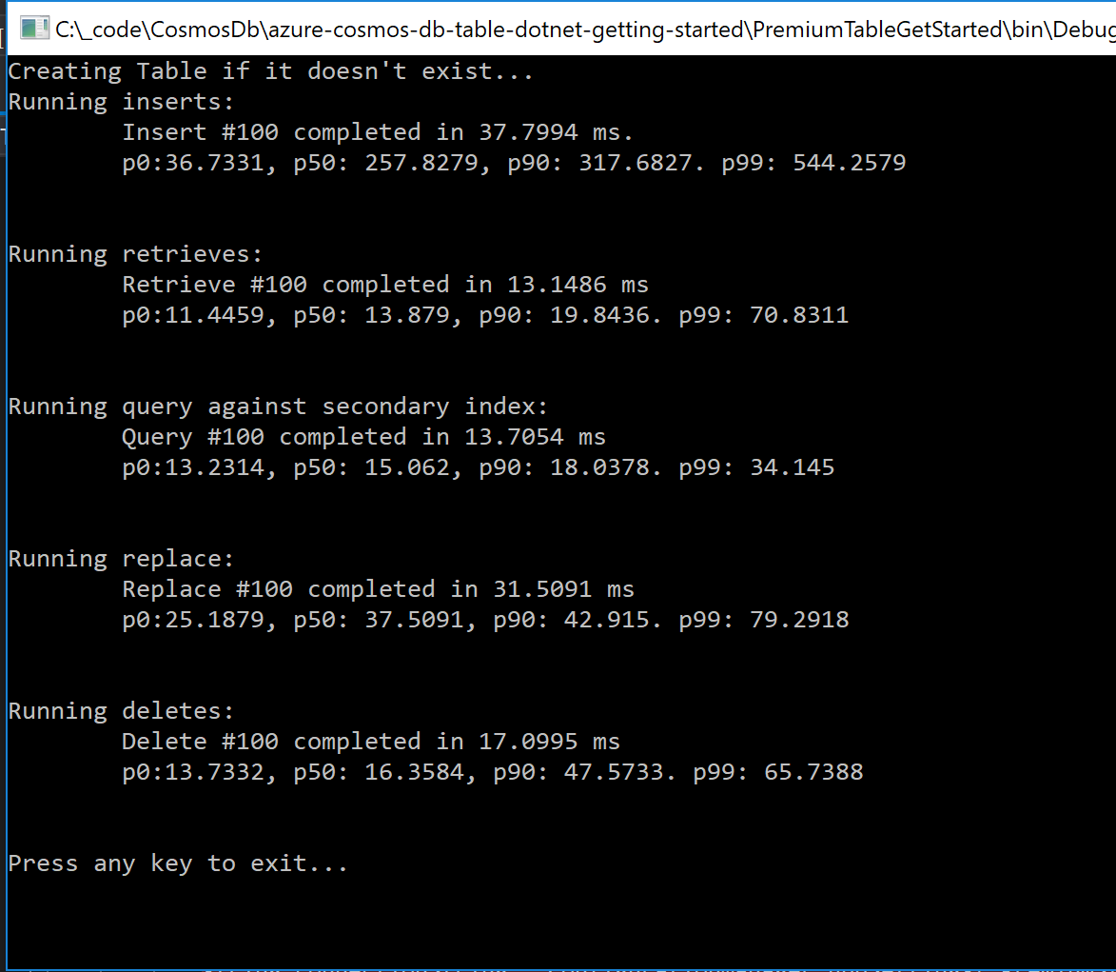
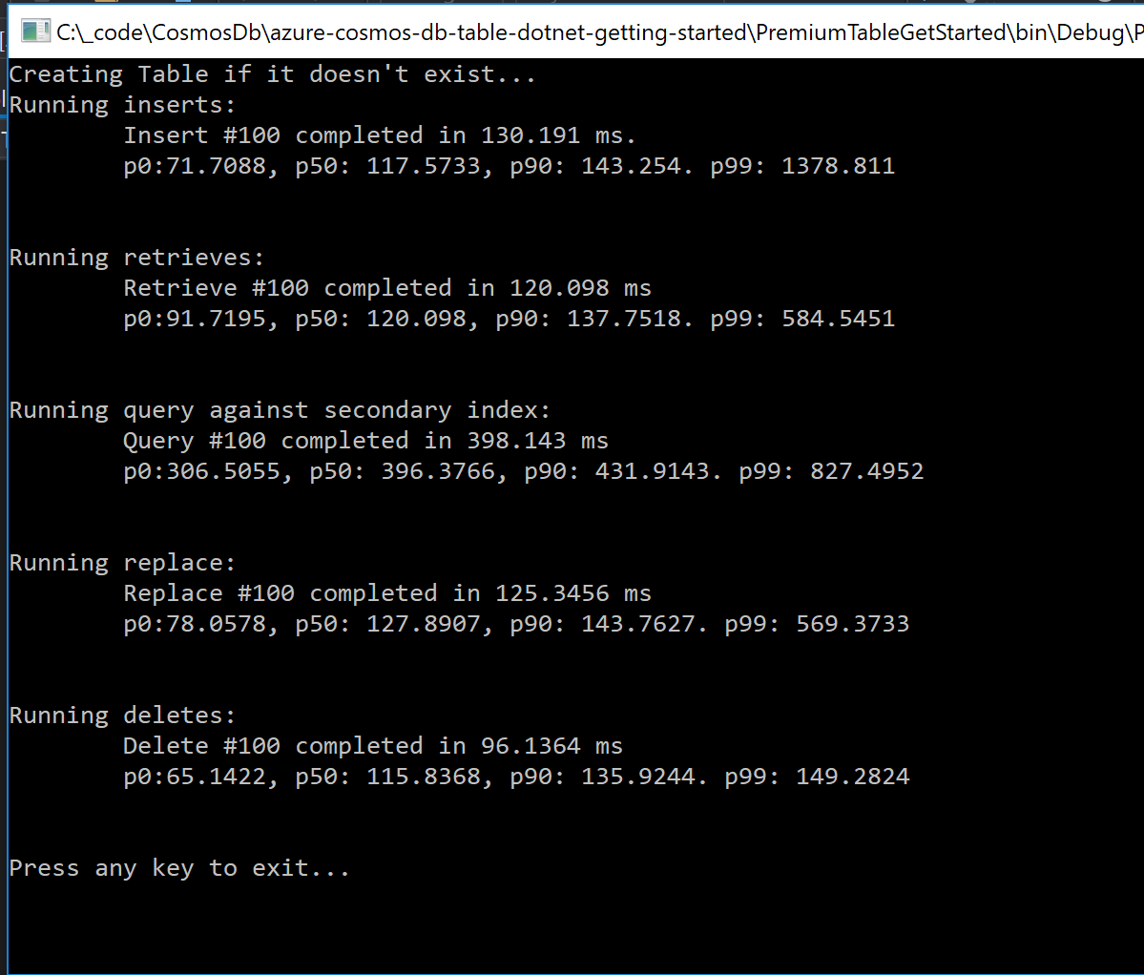

Slide 17

Azure Table Storage
Code Sample

Slide 18


Azure Redis Cache
In memory key-value store
Very fast reads (faster than table storage),
Used as a database, cache and message broker
Transactions
Expiration of items
Notes:
Memcached

Slide 19
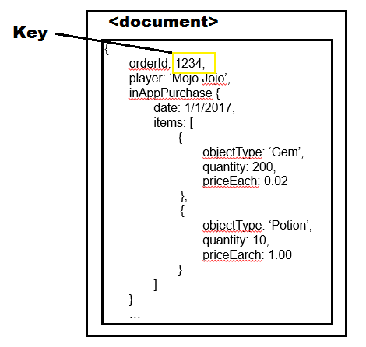
Document
Notes:
CouchDb,MongoDb
Similar to key/value, but may store complex objects
Documents in a document store are roughly equivalent to the programming concept of an object.
No set schema – need structure – Implicit Schema to get info out and to deserialize

Slide 20
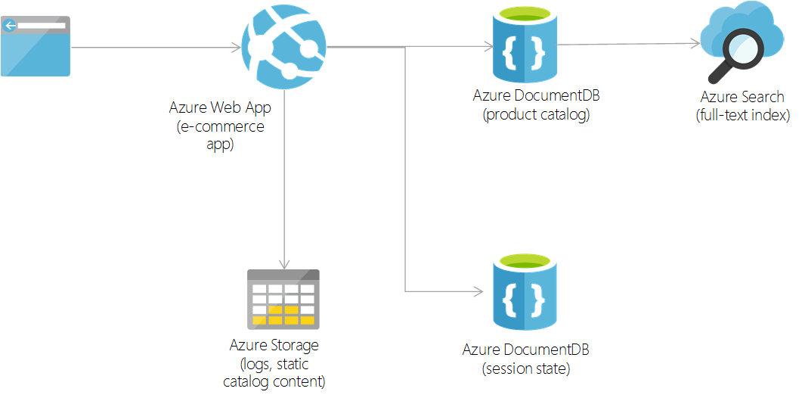
DocumentDb
Stores data in json
Schema-less
Stores complex, hierarchical data
Highly scalable
Notes:
Document size 2MB
Types of data: Json

Slide 21
DocumentDb
Code Demo

Slide 22
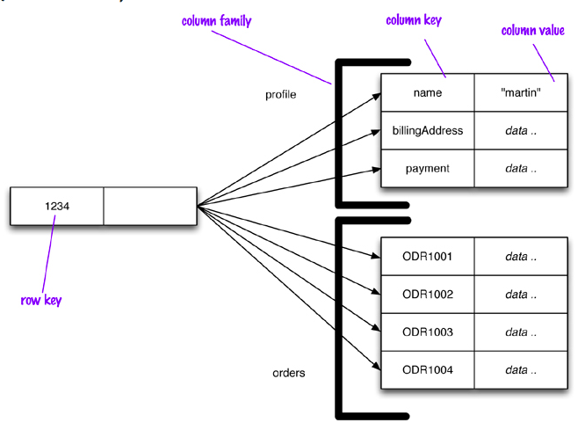
Column Family
Notes:
ColumnFamily: Azure Hbase/Apache Hbase/Cassandra (Apache)/BigTable
In column-oriented NoSQL database, data is stored in cells grouped in columns of data rather than as rows of data. Columns are logically grouped into column families. Column families can contain a virtually unlimited number of columns that can be created at runtime or the definition of the schema. Read and write is done using columns rather than rows
Instead of calling them tables, they are called columns. Unlike a table, however, the only thing that you define in a column family is the name and the key sort options (there is no schema).
A value is a tuple consisting of a name, a value, and a timestamp.
More complicated
Row key – can store multiple column families – columns that fit together
Retrieve by row key and column family name

Slide 23
Hbase
Part of the Hadoop eco system
Commonly augmented with Hive
Can handle very large amounts of writes in a short period of time
Notes:
Open source Built on Hadoop – modeled after Google’s BigTable
framework that supports the processing and storage of extremely large data sets in a distributed computing environment
Hive provides a database query interface to Apache Hadoop.
Imagine you had a file that was larger than your PC's capacity. You could not store that file, right? Hadoop lets you store files bigger than what can be stored on one particular node or server. So you can store very, very large files. It also lets you store many, many files.“
Move data to server

Slide 24
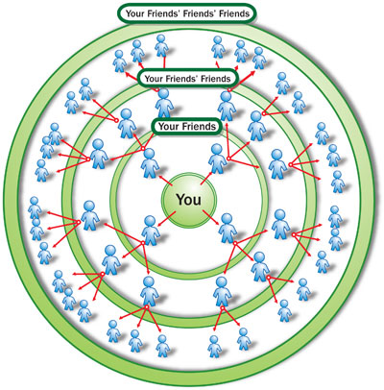
Graph
Notes:
Node and relationships – relationships are first-class citizens of db
Inbound/outbound -
Movie
Club

Slide 25
Gremlin
Nodes and relationships
Data with many complex relationships
Typically used to augment the system of record
Notes:
Customer with orders – products
Find all customer’s who’ve ordered a particular product – lots of work in traditional db
In graph – you have an order node, look at inbound relationship, connect to customer nodes
Typically used

Slide 26
Cosmos DB
Code Demo

Slide 27
Document
Key Value
Column Family
Graph

Slide 28
So How Do I Choose?

Slide 29

CAP Theorem
Never Gonna Get It
Consistency
CosmosDB
Hbase
SQL
CosmosDB
Partition Tolerance
Availability
CosmosDB
Azure Redis Cache
Notes:
Strong consistency is only guaranteed within a geo region, across geo regions the consistency guarantees are weaker. So the CAP statement theorem is only overcome within a certain geographic scope.
Consistent: Every read receives the most recent write
Available: Every request receives a response, but it may not be the most recent
Partition Tolerance: The system continues to operate despite dropped requests between nodes

Slide 31
Issues To Consider
What are the relationships
How much data, and how fast is it coming in
How the data will be accessed
Data access performance requirements
Consistency/Transactional requirements
Entity complexity
Programmer skill level
Notes:
Relationships: Data that has a lot of relationships don’t do as well in relational – Graph can get data with lots of connections faster than lots of joining
Scaling needs: FB – Column family database
Complexity – DocumentDb with json especially if you are going to serialize to json anyway
ORM has helped a lot – performance is often a problem

Slide 32
NoSQL Guidelines
Key Value
Column Family
Document
Graph
Lots of data
Simple data structure
Quickly perform small read and write operations
Inexpensive, fairly simple
Need to add data items willy nilly
Lots of data
Insanely huge amounts of data
Need high performance
No joins
Lots of data
Need high performance
More complex data structure
Need to add data items willy nilly
Lots of data
Lots of connections between entities
Quickly changing relationships between entities
Notes:
CFDB is what happens when you take a database, strip everything away that make it hard to run in on a cluster and see what happens. (Ayende)

Slide 33
Common Use Cases
Azure Redis Cache
Leaderboards, Shopping Carts
Latest x items of anything
Deletes and filters
Cache
Azure Table Storage
Large amounts of data with a flat structure
Fast querying using the partition and row keys
DocumentDb
Product catalogs, gaming, social networking
Hbase
Voting, Race, anything with huge amounts of data being generated in huge bursts, telemetry
Gremlin
Social networking relationships, anything with complex and changing relationships between entities

Slide 34
Why Choose Only One?
Problem
Solution
Lots of data
Fairly simple data structure
Lots of small reads and writes
Need high performance
Need high availability
Need fast searching on columns other than the key
Use Azure Storage
Augment with Redis Cache for searching
Notes:
It always sounds easy - "use the best tool for the job". With very isolated systems, it's easy to decide RDBMS for one application, Redis for another and Cassandra for somethings else. When it comes time to building systems with multiple persistent stores, we're met with challenges in integration, existing applications, and push back from IT administrators.

Slide 35
Demo
Azure Table Storage with Redis Cache

Slide 36
Why Choose Only One?
Problem
Solution
Really need high consistency
Highly structured data
Current data is not really large
Historical data is huge
And we need to report on historical data
Use Azure Sql
Archive to DocumentDb

Slide 37

Don’t Forget Good Ole SQL
Just cause it’s old, doesn’t mean it’s not cool anymore

Slide 38

Resources
Anne Bougie
anne.bougie@gmail.com
@bougiefever
http://www.bougiefever.com
https://github.com/Bougiefever
Slides on SlideShare: https://www.slideshare.net/AnneBougie/azure-database-options-nosql-vs-sql
A Newbie Guide to Databases https://blog.appdynamics.com/engineering/a-newbie-guide-to-databases/
That NoSQL Thing: Column (Family) Databases https://ayende.com/blog/4500/that-no-sql-thing-column-family-databases
NoSQL Distilled: A Brief Guide to the Emerging World of Polyglot Persistence http://a.co/1YwtJ47
On Sharding Graph Databases http://jimwebber.org/2011/02/on-sharding-graph-databases/
Azure Cosmos DB Documentation https://docs.microsoft.com/en-us/azure/cosmos-db/
Notes:
https://vimeo.com/68320412
https://martinfowler.com/bliki/PolyglotPersistence.html

Slide 39

The End

